Slide 1


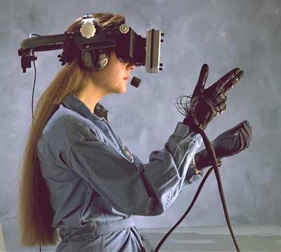

Slide 2
What VR is not:
- VR is not just any form of Computer Graphics
What VR is:
- “A system for providing an interactive exploration of a three dimensional virtual environment”
“The use of 3D graphics displays to explore a computer generated world”
- An attempt to model the real world as believably as possible
- An advanced form of human computer interface

Slide 3

A typical VR system consists of six main components grouped into two:
a. Internal Components:
i. Virtual world ii. Graphics Engine
iii. Simulation Engine iv. User interface
b. External Components:
i. User inputs ii. User outputs

Slide 4

A scene database containing the geometric representations and attributes for all objects within the environment

Slide 5

Responsible for actually generating the image or scene, which a viewer will see
Usually the scene database and the viewer’s current position and orientation is taken into account
It also includes other information form the scene data base e.g. sounds, special effects textures etc

Slide 6

Does most of the wok required to maintain virtual environment
Concerned purely with the dynamics of the environment
- how it changes over time
- how it responds to the user’s actions
This includes handling interactions, physical simulations (gravity, inertia)

Slide 7

Controls how the user navigates and interacts with this virtual environment

Slide 8

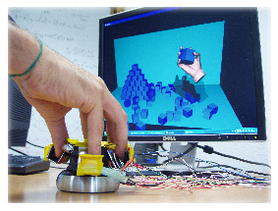
i. Desktop VR
- Based on the concept that the potential user interacts with the computer screen with out being fully immersed and surrounded by the computer generated environment
- Applications domains involve architecture, industrial design, data visualization
- Less cost and involves less use of interacting technology

Slide 9
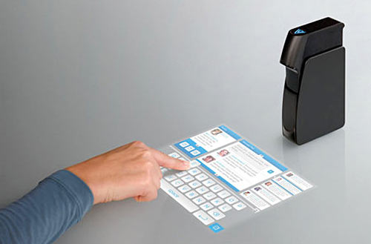
ii. Projected VR
- Based on overlapping of the image of the real user on the computer generated world
- A special movement tracking device can capture the movements of the user and enter them so that they can cause actions and reactions in the virtual world
- Often used in VR Art shows

Slide 10
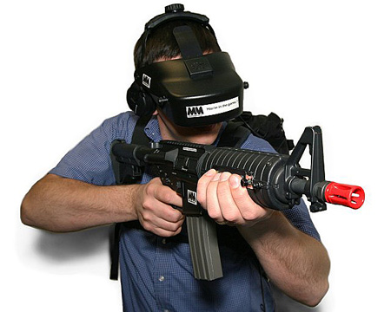
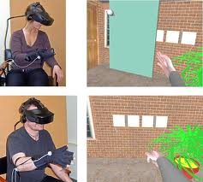
iii. Immersive VR
- The user appears to be fully inserted in the computer generated environment
- Illusion rendered by providing HMD (Head Mounted Device) with 3D viewing and a system of head tracking that gives the exact correspondence and coordination of the user’s movements with the feed-back of the environment
- The goal is to completely immerse the user within a synthetic environment or make them feel a part of that environment

Slide 11
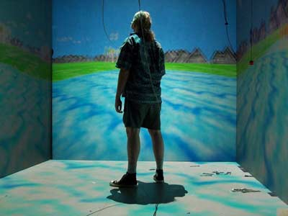
iv. CAVE or Fish Tank VR
- Cave is a small room where computer generated world is projected on the front and side wallsusing projectors
- Suitable for collective VR experience (allows different people to share the same experience at the same time)
- e.g. cockpit simulations

Slide 12
v. Tele-presence
Here, users can influence and operate in a world that is real but in a different location
Telepresence is used for remote surgical operations and for exploration and manipulation of hazardous environments (space, underwater)
Remote robots used in bomb disposal operations

Slide 13
vi. Augmentation
- mixed reality provides a half way point between an non immersive and fully immersive VR system
- a user’s view of the world is supplemented with virtual objects and items whose meaning is aimed at enriching the information content of the real environment
e.g. Head Up Displays (HUD)
- Used in modern military aircraft
- These superimpose flight data such as altitude, air speed upon the pilots field of view
- This can be on a cockpit mounted display or upon the pilot’s helmet visor

Slide 14

Software packages exist that allows users to either experience virtual worlds or even create and edit them
3D graphics engines and immersive environments has occurred in the gaming industry
Most VR Packages are costly and require high specification workstations to run properly

Slide 15

Factors that can attribute to a realistic and believable virtual environment:
Visual realism:
- The level of realism in a scene helps considerably in making a believable environment
- With best applications, the viewer does not notice any transition between real footage and computer generated effects
- But it requires a lot of rendering time

Slide 16
Image Resolution
- Image resolution is closely linked with visual realism
- Computer generated images contain pixels , the size and number of these are dependent on the display size and resolution
- The color and intensity at each pixel must be generated individually, putting a heavier load on the graphics system

Slide 17
Frame Rate
- To give the impression of a dynamic picture, the system updates the display very frequently with a new image
- Images stop flickering at frequencies above CFF which can be as low as 20 Hz
- Normal TV broadcasts update at a frequency of 50 Hz in the UK , 60 in the US
- Achieving this refresh rate puts a heavy load on the graphics system

Slide 18
Latency
- Latency or lag is the delay induced by the various components of a VR system between the user’s inputs and the corresponding response from the system in the form of a change in the display
- As latency increases a user’s senses become increasingly confused as their actions become more and more delayed
- Chronic cases can result in simulator sickness, hence latency must be kept to a minimum

Slide 19

Flight Simulation
- For Pilot training
- Safe and realistic
- Risk free

Slide 20
Engineering and design
- CAD and CAM
- View products as it would be seen when manufactured

Slide 21
Human factor modeling
- Used to model human behavior in the design of new products or buildings
e.g. simulation of fire in a building and a user can view how the virtual occupants react to the emergency
- Helps in designing escape strategies, fire modeling, human behavior

Slide 22
Visualization
- Data visualization

